Slide 1
Bienvenidos a la clase de Señora Shea
Canciones de Celia Cruz: https://www.youtube.com/watch?v=LwxI3q2GDUI
This year I teach only one class from 10:30 - 11:10, so students can ask me questions before or after class without cutting into class time.
They should still be working on homework every day as this class is still 20 minutes shorter than the one offered at the HS, but I am giving them longer to complete Quizlets and collecting their daily work on Thursdays.

Slide 2
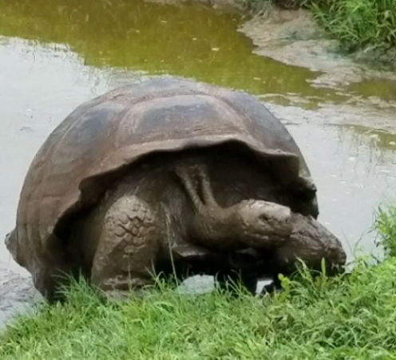
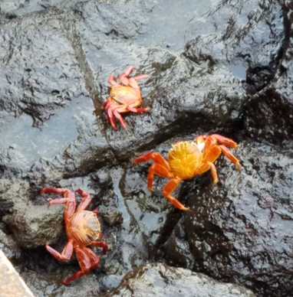
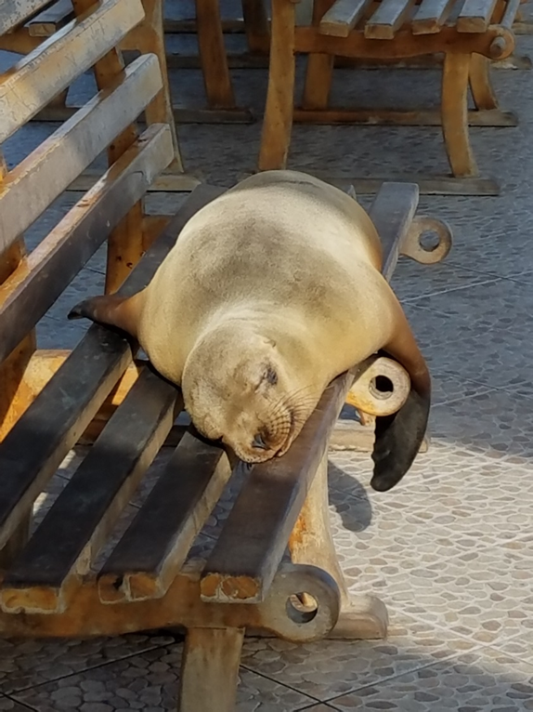
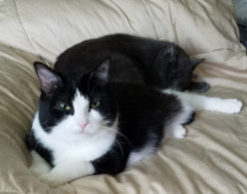
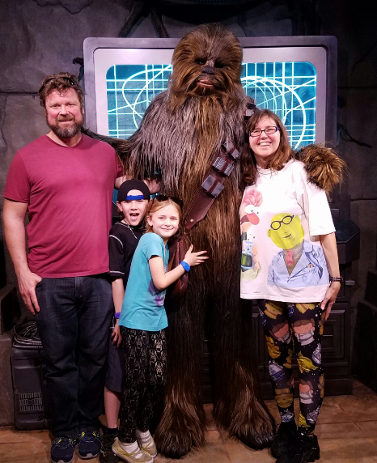
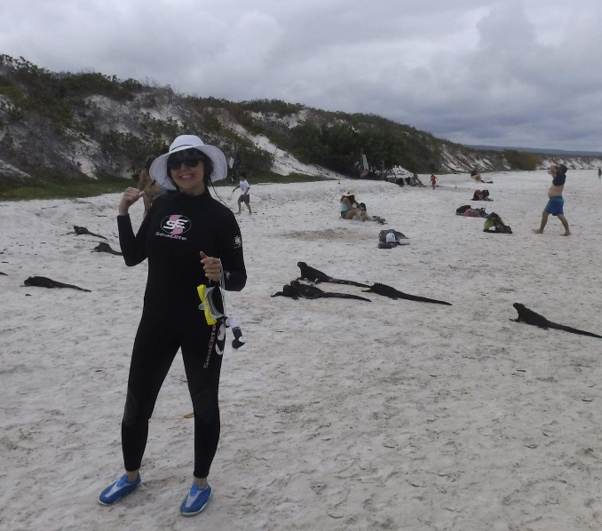
A little about me…
I caught and fixed over 10 stray cats in my previous neighborhood on Fox Hill, and two of them caught me. So they’re my house cats.
I enjoy teaching Spanish so much that I’m going back to school to get my secondary certification at Oakland University so I can teach at the HS as well.
I love to travel, and I’ve traveled to Spain and many countries in Latin America, as far south as the Galapagos Islands, Ecuador.
I have 2 kids (10 and 13), and my daughter and I love Star Wars.
My hair grows fast, so I like to donate it to Wigs for Kids.

Slide 3
This year we will be speaking and listening a lot more. We are working on this everyday.
*Each class starts and ends with a Spanish song
(or a song to help us remember Spanish)
*Many days a week we will be doing ENTREVISTAS RÁPIDAS
Where they have a minute at a time to ask and answer as many
Questions as possible, using the target vocabulary
Currently we’re finding out about everybody’s daily routines…
What time we wake up and get up, shower, brush our teeth,
get dressed, go to sleep…
*I’m bringing in more authentic listening activities as well, to help
train their ears to listen to native speakers

Slide 4
Our curriculum: After the first semester, the students will be able to
Describe themselves and others
Discuss likes and dislikes
Talk about daily routines
Share fitness goals and what to do to be healthy
Practice giving and receiving advice with positive and negative commands and the verb deber
Ask for and give opinions about clothing
Know how to get help from a clerk in a store
Start talking about past events that had a definite beginning and ending, using the preterite
Saying where they went
Telling what they did there

Slide 5
Our curriculum: After the second semester, the students will be able to
Talk about plans
Discuss how they have celebrated holidays in the past
Learn vocabulary for party preparation
Continue to practice greeting and introducing others, expanding on what they learned last year
Discuss travel
Asking for information in an airport
Talking about where they have been
Continue with travel
What activities did you do on a trip
Where do you hope to go and what you would do there
Discuss jobs
Tell what people do at their jobs
Talk about future jobs that sound intereting
Introduce people, saying what they do
Describe your house and chores
They will also learn how to complain about the chores they have to do

Slide 6
2 books this year
Exprésate Spanish 1 (chapters 7-10 and review of 1-6 from last year)
Exprésate Spanish 2 (chapter 2)
We haven’t used the book too much this year, but we will use it for class work so they should continue to bring it
They can also use it for reference, glossary in the back, vocabulary
They won’t get the 2nd book until sometime next year

Slide 7
Your child should be practicing Spanish at home every day
There will be at least one Quizlet a week, sometimes more like this week.
Currently I’m having Quizlets due on Mondays (but our extra one this week is due on Wednesday)
THEY SHOULD REVIEW THEIR CLASS NOTES EACH NIGHT—I will collect their Hazlas (Do thems) that we do as seat work every Thursday to fix misunderstandings
There will occasionally be projects or other work assigned (possibly from the book)
Our first project was ¿Quién soy? (Who am I?)
The ones I’ve shared so far are posted
We are doing a few anytime we have some spare time, and the students enjoy guessing who the person is
Our next project will be a Rutina diara (Daily Routine) project

Slide 8
Absences
*When your child is absent, they need to look at my PowerPoint of plans for the week, find the day they were absent and see what they missed.
*They are responsible for doing the seatwork (hazla) that they missed.
*They also need to watch any video or ask about any other activities they missed. Including turning in homework that was due when they were gone.
*They need to check the absent folder when they return. (If there aren’t notes in there, they should ask.)

Slide 9
Please check PowerSchool
I keep it up to date.
Check comments too as I sometimes include them. I included them on the ¿Quién soy? Project grade as I didn’t pass it back as it is/will be posted after we share it.

Slide 10
Classroom expectations
The same as last year
Students need to ACTIVELY participate in Spanish.
They should not be speaking English unless they are trying to figure something out and need an explanation in English. WE ARE STILL WORKING ON THIS.
We have a big class (29) and limited time. Talking to their neighbors in English is very disruptive.
I have had to assign seats this year due to chatting. I may move students again.

Slide 11
I want my students to be successful, so they can always ask if I’ll accept a redo. A redo will be worth 90% of what they score, and if it’s a test redo, I may make an alternate test.

Slide 12
Emails from me…
I will continue to try to send out emails about upcoming events, and this year I am also including the students on the emails.
PLEASE LET ME KNOW IF YOU HAVEN’T RECEIVED ANY EMAIL FROM ME YET ☺

Slide 13
I look forward to a fun year!
Any questions?

